Slide 1



Enhancing Service Quality through Real-time Emotion Analysis
Mohit Krishnia (Project Leader)
Gaurav Bhaskar
Nishant Nehra

Slide 2


Contents
Face Data Collection
How Excel Files Created
Training Model
Real Time Detection
Real Time Emotion Detection
Mode using in each periods
What’s Its effect
Applications

Slide 3
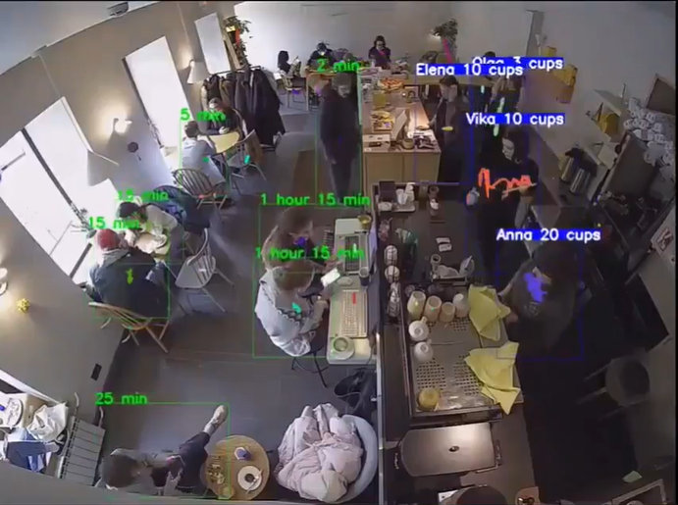
Idea Behind This Project
As Camera is most essential thing in AI to detects and
Mimics human like behaviour.
As in this coffee shop the ai detects no. of cup per worker
And client sitting time.
So I want that we develop a model which also detect
Emotion on their services and that’s how I start my project
Journey of Enhancing Services by emotion detection.

Slide 4

Face Data Collection
Collecting the Face Data of - Students
- Teachers
This would help in Recognizing the face.

Slide 5
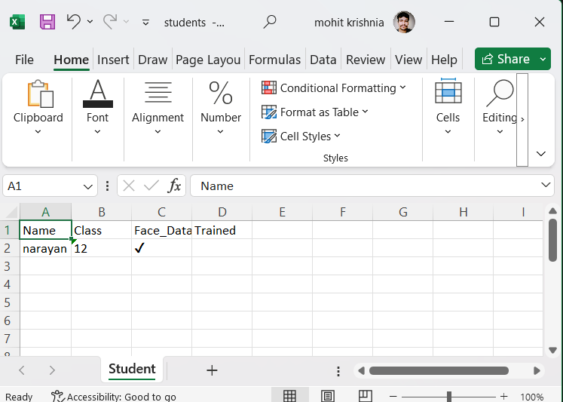
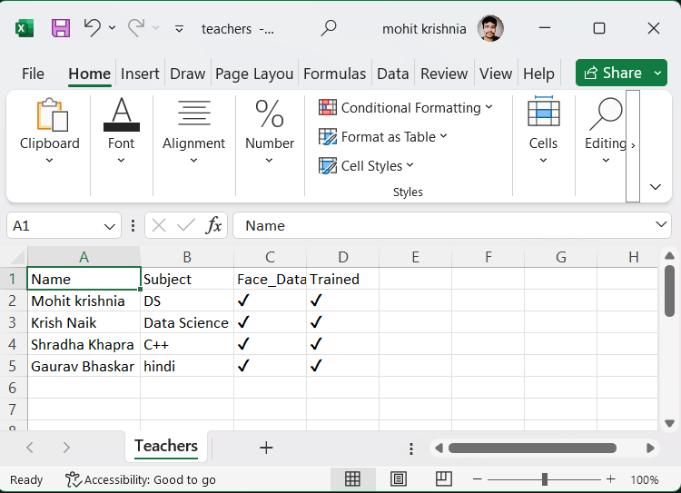
Getting Excel Ready for teachers and students for the admin after taking the face data

Slide 6
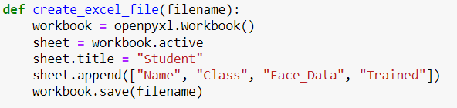
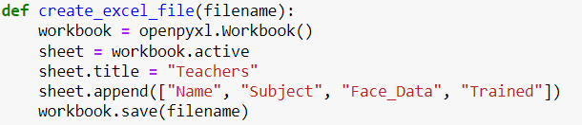
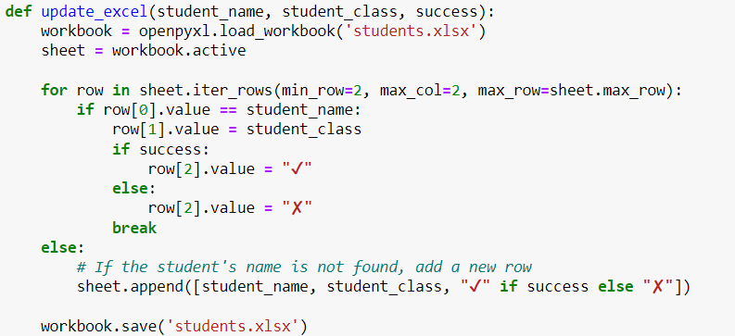
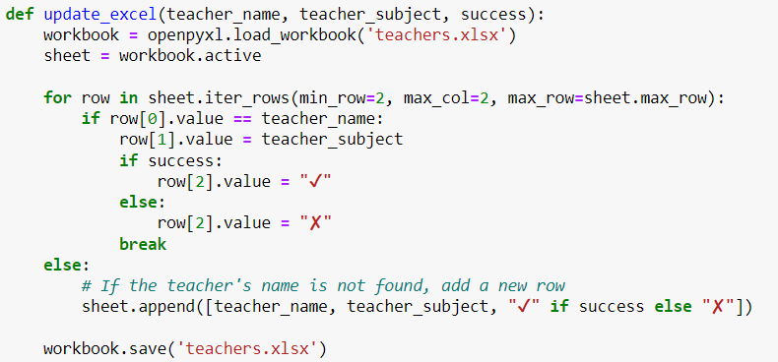
How Excel Files were created
Generating Excel file for students.xlsx
Generating Excel file for teachers.xlsx
This is where we put tick on third column if face data collected and in fourth column tick when it is trained successfully

Slide 7
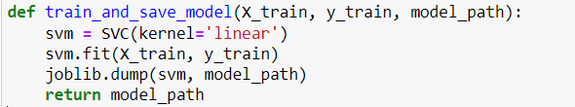
Training Model( Face data)
Here we are using SVC ( Support vector machine) to train our datasets(images) folder model
So after training the model we get Pickle file for both students as well as Teachers
Students
Teachers

Slide 8
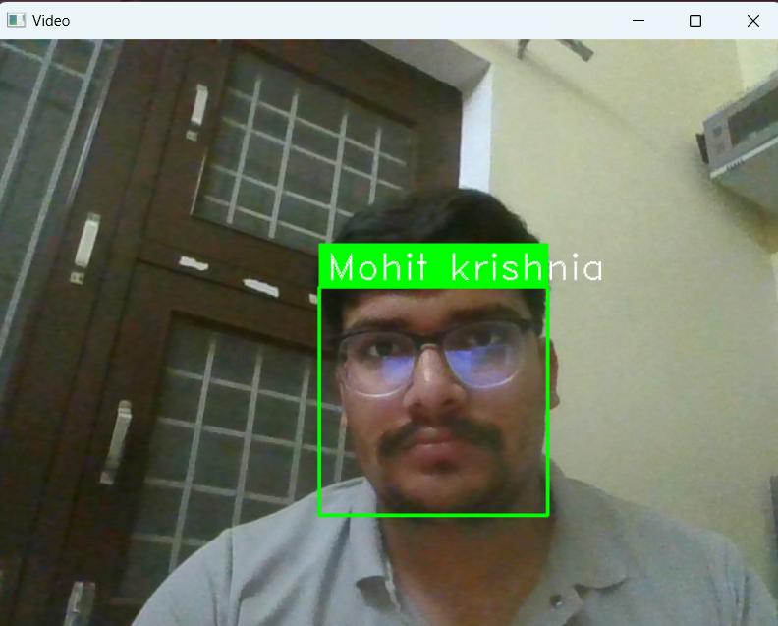

Real Time Detection
To Test our model for teacher and student we can run real time person recognition code.
We can done real time face recognition by our pickle models mainly :- trained_model.pkl & students_trained_model.pkl
This is for testing purpose to know that our model recognize the person whose face data we have or not.
That’s how it recognize the student and teacher during real time scanning

Slide 9
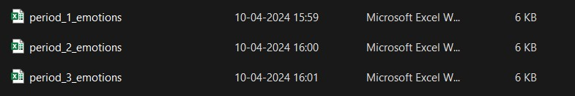

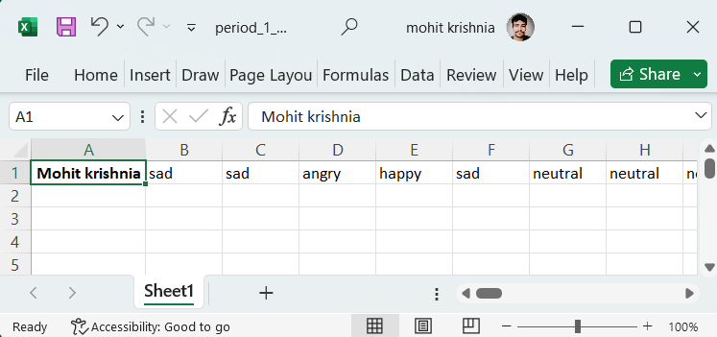
Scanning Students Face Emotions and storing to the Excel Files.
First we declare total no. of period and there time
So after fully execution of our code we get excel file of each period
So that’s how we get inside of our each period excel file . Those who are detected we get there name with emotions/ second

Slide 10

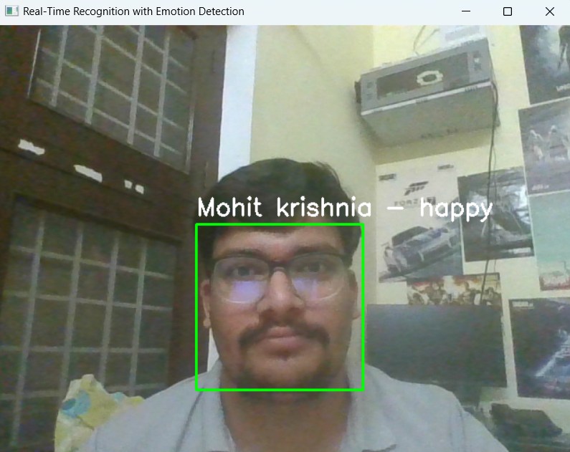
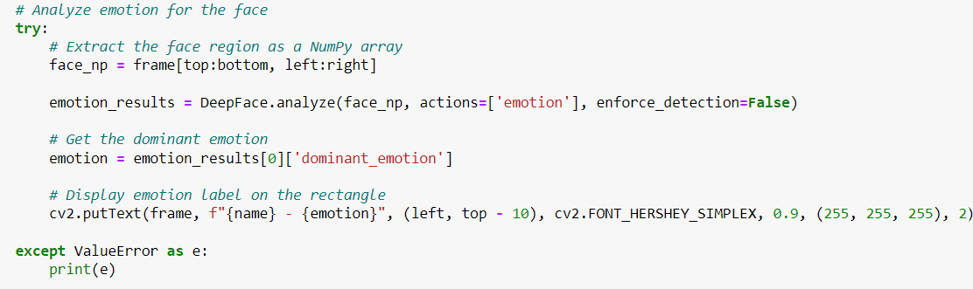
Real time emotions Scanning
We Run our Real Time Emotion capturing program
And So that’s how we store each frame emotion in our excel sheet

Slide 11
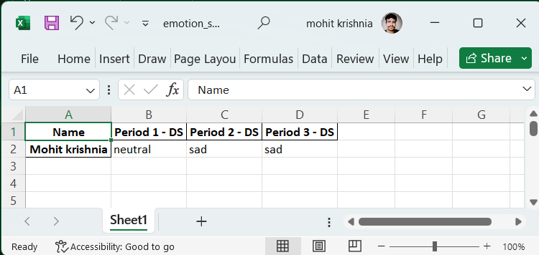

Now detecting teacher in each period
Now we try to scan first 10 second of period to capture teacher :-
If teacher face Detected Move to students emotion capture.
If not then increase 5 more second till teacher detect.
As you can see along with the period column
Subject is mentioned.
This is done by scanning teachers face and fetching
Out their subject from their data.
We Capture teacher for their subject to put along period column in excel.

Slide 12

Mode Using for each period
As we see here there are a lot of entry in period
Excel file for each student .
So at final we make a mode operation to find out
Most emotion for each student
As you see that above excel file is of period 1
And in below excel file we get mode of period 1

Slide 13
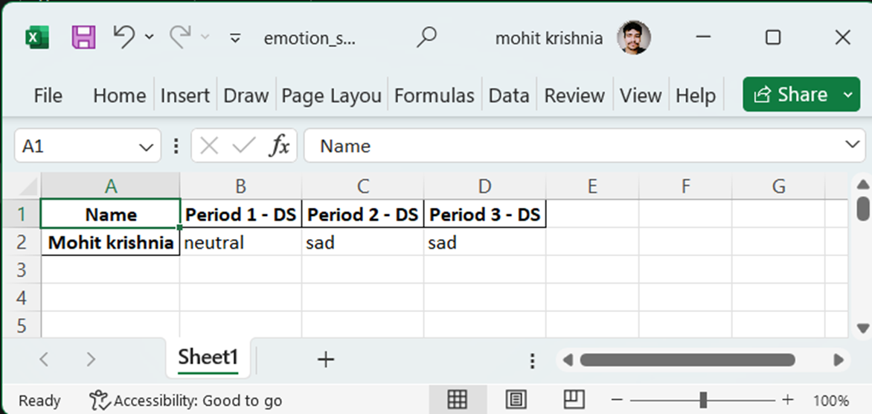
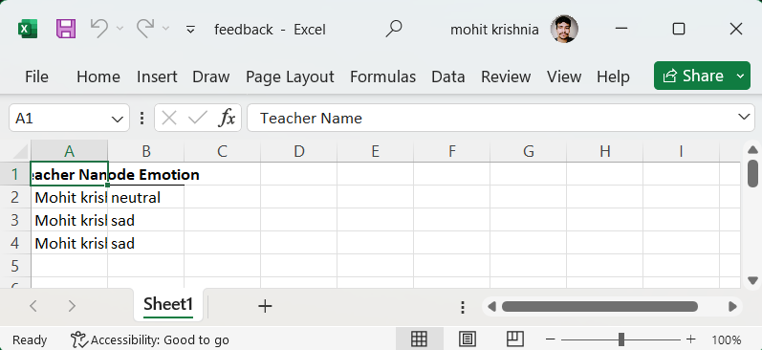
Now making mode for teachers
As students we make mode of them raw wise for each students
Now we do same for the teachers as well as by column wise
As we have same subject in periods so mean same teacher for all periods. So excel file for teachers feedback is :-

Slide 14
What’s Its effect
We have data of each students. So we can make their result better by adding more insight to them.
We have teachers data. So the admin can improve teachers quality by this data.
We can also show this result of students to the parents so they gona know what’s their child status.

Slide 15

Applications
Medical Hospital for patient mood analysis.
Hotel to know clients mood on their services.
Online classes to know teacher attractiveness.
Café to know client satisfaction according to the order
E commerce to know client experience using their UI.
Production Houses to know workers mood .
Elections to know voters mood respective their speeches.

Slide 16


